Slide 1
Public Schools Foundation of Tippecanoe County Grant Program

Slide 2
Gina Boyd
@4th5thGT
4/5 High Ability Teacher
Mayflower mill elementary
Notes:
I’ve been a grant writer and I’ve also been an evaluator. Tell Michelle Sanson story.

Slide 3
PSFTC has changed the way my students learn.
6 grants since 2003 totaling over $10,000

Slide 4
Examples of Classroom Materials Purchased
NookColor eReaders
Caldecott Medal-winning picture books
National Parks passports
Class sets of nonfiction books
Blank books
Surgical masks

Slide 5
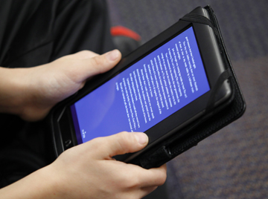
NookColor eReader Grant photo courtesy of the Journal and Courier
Notes:
Reporting lays the groundwork for your next grant to be funded. Be sure to publicize what you’re doing!

Slide 6
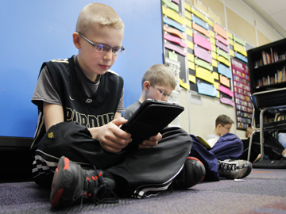
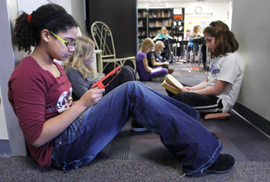
NookColor eReader Grant photos courtesy of the Journal and Courier

Slide 7
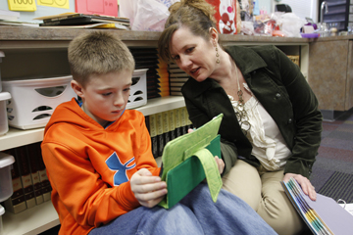
NookColor eReader Grant photo courtesy of the Journal and Courier

Slide 8
Turn and Talk
What is it that you want to purchase with this grant?

Slide 9
Grant-writing Tips
Have a clever or catchy title.

Slide 10
Curl Up with a Good “Nook” to “Kindle” a Love of the Scientific Process

Slide 11
One “Flu” Over the Hoosier State

Slide 12
Grant-writing Tips
Have a clever or catchy title.
Use a colon in your title to elaborate.

Slide 13
Think Inside the Box: Sharing Math Fun With Younger Learners

Slide 14
Passport to America: An Exploration of the National Parks of the United States

Slide 15
Write a title!
a grant written by middle school science and social studies teachers who want to teach a unit together on how technology affected settlement of the US

Slide 16
Grant-writing Tips
Have a clever or catchy title.
Use a colon in your title to elaborate.
Keep a potential grants file.

Slide 17
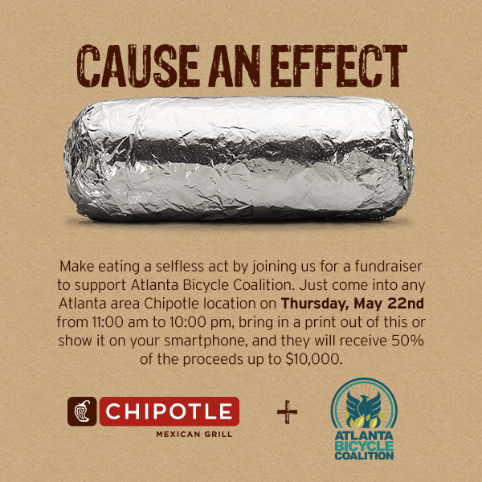
Potential Grant Title

Slide 18
Grant-writing Tips
Have a clever or catchy title.
Use a colon in your title to elaborate.
Keep a potential grants file.
Don’t ask for less than $1000.

Slide 19
Grant-writing Tips
Have a clever or catchy title.
Use a colon in your title to elaborate.
Keep a potential grants file.
Don’t ask for less than $1000.
Use bullets.

Slide 20
Grant-writing Tips
Have a clever or catchy title.
Use a colon in your title to elaborate.
Keep a potential grants file.
Don’t ask for less than $1000.
Use bullets.
Explain what has already been done to address the need.

Slide 21
Grant-writing Tips
Have a clever or catchy title.
Use a colon in your title to elaborate.
Keep a potential grants file.
Don’t ask for less than $1000.
Use bullets.
Explain what has already been done to address the need.
Add a community connection.

Slide 22
Grant-writing Tips
Have a clever or catchy title.
Use a colon in your title to elaborate.
Keep a potential grants file.
Don’t ask for less than $1000.
Use bullets.
Explain what has already been done to address the need.
Add a community connection.
Find out your school’s free and reduced lunch percentage and use it to demonstrate need.

Slide 23
Grant-writing Tips
Have a clever or catchy title.
Use a colon in your title to elaborate.
Keep a potential grants file.
Don’t ask for less than $1000.
Use bullets.
Explain what has already been done to address the need.
Add a community connection.
Find out your school’s free and reduced lunch percentage and use it to demonstrate need.
Increase your grant effect size by building in sharing of knowledge.
Notes:
Have your students share what they learn with younger students or fellow students. Suddenly, a grant that initially only affects 30 kids can potentially affect a whole school. Or plan to share what YOU learn with other teachers at a conference.

Slide 24
Grant-writing Tips
Have a clever or catchy title.
Use a colon in your title to elaborate.
Keep a potential grants file.
Don’t ask for less than $1000.
Use bullets.
Explain what has already been done to address the need.
Add a community connection.
Find out your school’s free and reduced lunch percentage and use it to demonstrate need.
Increase your grant effect size by building in sharing of knowledge.
Collaborate with others!
Notes:
Have your students share what they learn with younger students or fellow students. Suddenly, a grant that initially only affects 30 kids can potentially affect a whole school. Or plan to share what YOU learn with other teachers at a conference.

Slide 25
Grant-writing Tips
Have a clever or catchy title.
Use a colon in your title to elaborate.
Keep a potential grants file.
Don’t ask for less than $1000.
Use bullets.
Explain what has already been done to address the need.
Add a community connection.
Find out your school’s free and reduced lunch percentage and use it to demonstrate need.
Increase your grant effect size by building in sharing of knowledge.
Collaborate with others!
Think about assessment early on in your writing process.

Slide 26
Grant-writing Tips
Ask yourself, “What am I really trying to do with this grant? Take a step back from what you think you want.”
Notes:
Here’s what we all want – to help kids learn better! Whether that’s by trying to get rid of bullying or connecting them to music or drama or whatever. Our ultimate goal is to help kids learn.

Slide 27
Think about this:
What do you really want?.

Slide 28
How can we make this about MORE?
a high school general music teacher wants to buy a better sound system

Slide 29
How can we make this about MORE?
A third grade math teacher wants a set of math games called VersaTiles

Slide 30
How can we make this about MORE?
three middle school teachers want to go to a technology conference

Slide 31
How can we make this about MORE?
Kindergarten teachers want to take a field trip to a MakerSpace at a science museum

Slide 32
How can we make this about MORE?
a high school science teacher wants to pay for ten students’ membership fees to start a local chapter of a national robotics club

Slide 33
Mistakes I’ve Made Writing Grants
Including the name of my school in the body of the grant.
Notes:
Explain blind review. Tell Steve Z story about PSFTC.

Slide 34
Mistakes I’ve Made Writing Grants
Including the name of my school in the body of the grant.
Not following directions.
Notes:
$25,000 NEA grant where I didn’t double space

Slide 35
Ask me questions via Twitter or email!
@4th5thGT
gboyd@tsc.k12.in.us

